Slide 1
CIS 4930-001: Introduction to Augmented and Virtual Reality
Introduction to Virtual Reality

Slide 2
PhD
Research Assistant Professor
Assistant Professor
2004
2010
2015
Problem Domain
Computer
Graphics
Scientific Visualization
Data Visualization

Slide 3
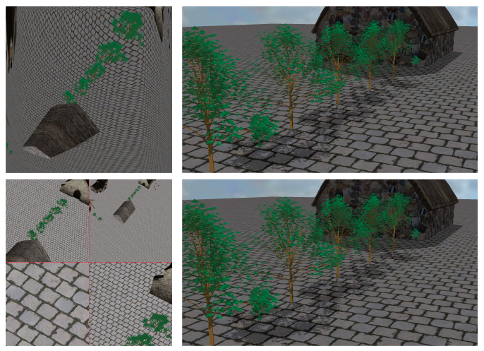
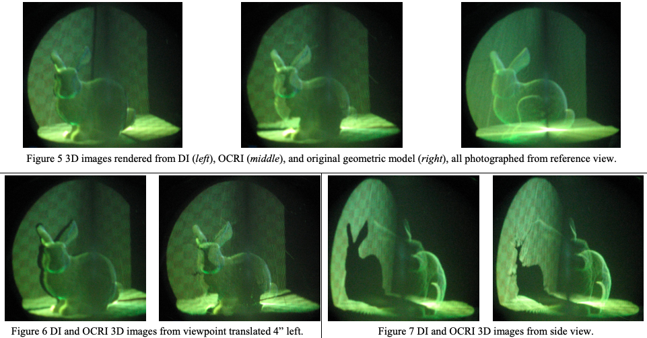
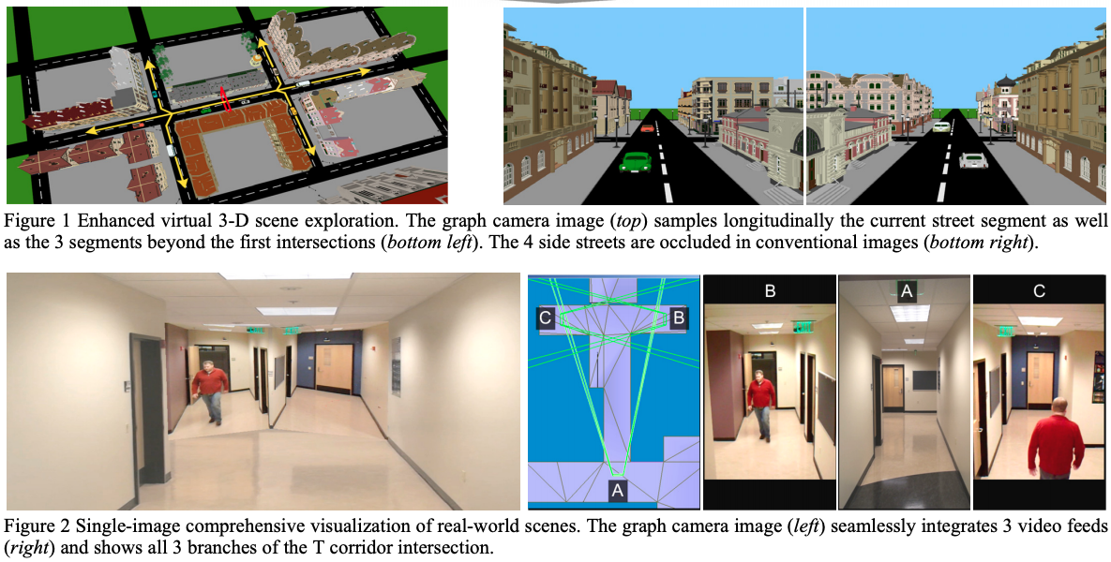
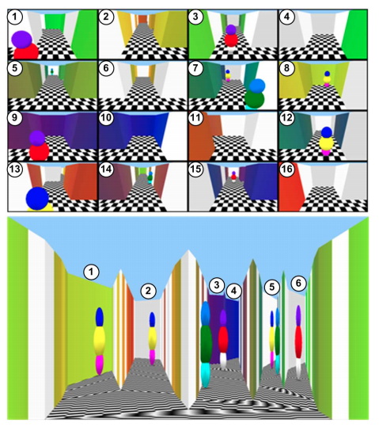

Slide 4
Introduce yourself
Name
Background (department, year in school)
What are your interests in / exposure to in AR/VR?
A few thing we will assume that you are all familiar with:
Linear algebra
OO programming (C#)
You will teach each other practical aspects of AR/VR, such as using Unity3D, Blender, Maya, Photoshop, etc.

Slide 5
Course Topics
What Augmented Reality/Virtual Reality is
How to design good AR/VR experiences
History of AR/VR & current status of the business
Understand how VR works (engineering + psychology)
Broad overview of the area of Computer Graphics & Real-time Rendering
How to build your own AR/VR applications

Slide 6
Single Semester-long Group Project (w/ many milestones)
Week 1: Form project groups and develop project ideas
Week 2: Project pitch
Week 3: Formal project proposal
Week 8: Mid-Project Progress Report/Demos
Week 10: Peer demo & feedback
Week 13/14/15: Final project demos
Week 15: Project Due
In addition, each team will be responsible for presenting one (1) tool/technique lecture to the class (30 minutes)

Slide 7
What is in the lab
Room: ENB 217
Hours: see syllabus
Workstations x2
* Note: This is an active research lab. Please be respectful with noise, food, etc. when working in the lab.
Vive Pro
Acer Chromebook Tab 10 (ARCore)
Oculus Go

Slide 8
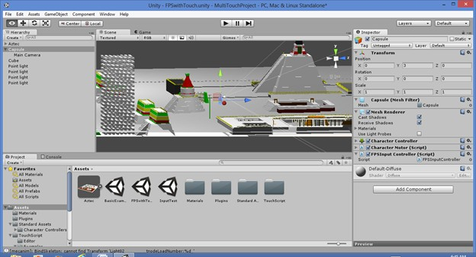
Unity3D

Slide 9
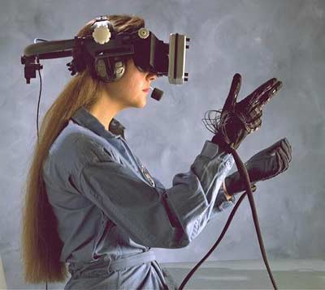
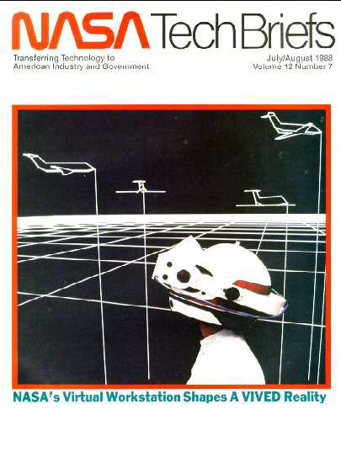
What is Virtual Reality
Circa 1985

Slide 10
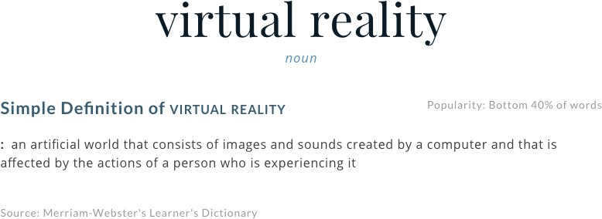

Slide 11





Virtual Reality Goal
Take human senses (interfaces)
Visual
Audial
Haptic/Tactile
Scent
Taste
Neural
Replace with computer generated data
Dynamics, visuals, AI, networking
Basically everything in science...!
Create sense of immersion

Slide 12



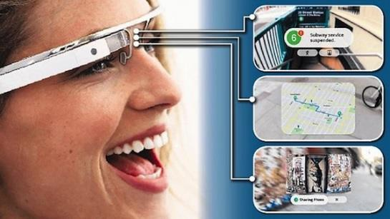

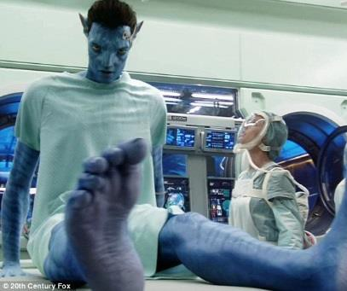

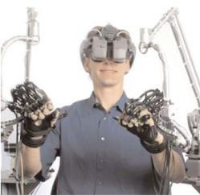

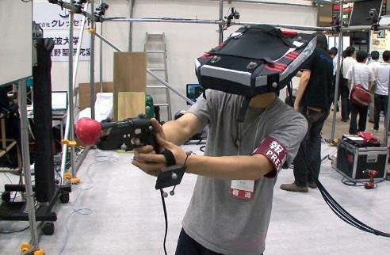
Categories of VR
Desktop VR
3D world shown on monitor, mouse and keyboard input to interact
Low cost, standard PC
Games, Simulators
Augmented Reality
A seamless mix between real world and Computer Graphics (CG) as well as sound. (e.g. Microsoft Hololense)
Telepresence
The use of various technologies to produce the effect of placing the user in another location
Immersive VR
Using other display technologies (helmets, walls, …
User tracked in some sense

Slide 13
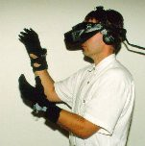
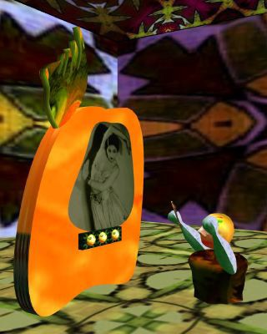
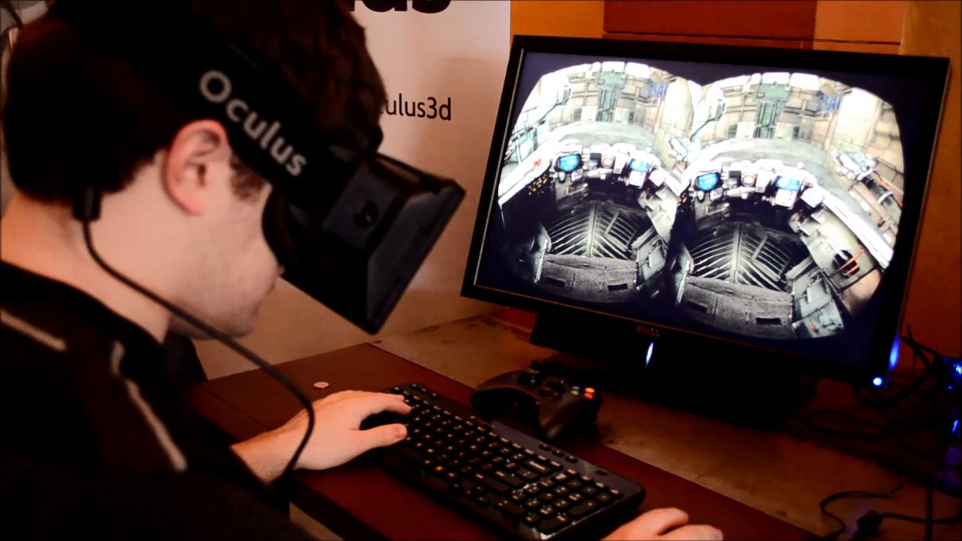
Immersive VR
Head mounted display, gloves
Separation from the real world

Slide 14
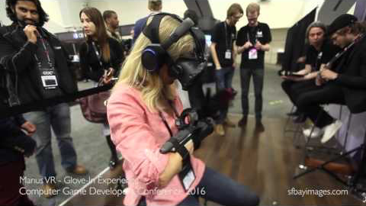
VR Goggles and Gloves
https://youtu.be/Ak-Bt7IM8Jc

Slide 15
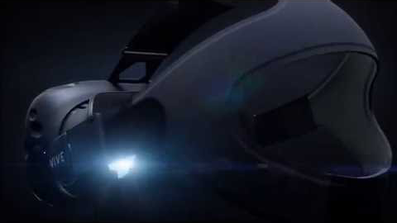
Example Vive App – Tilt Brush
https://youtu.be/ijukZmYFX-0

Slide 16
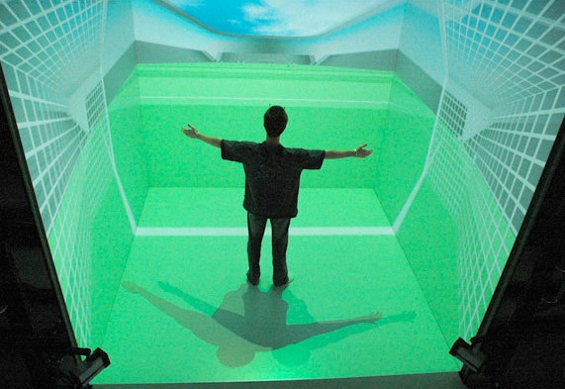
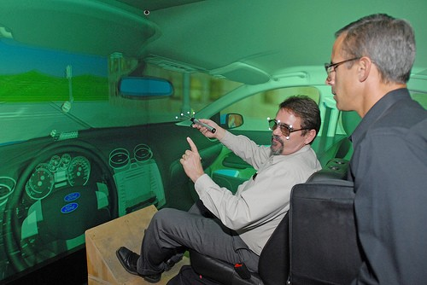
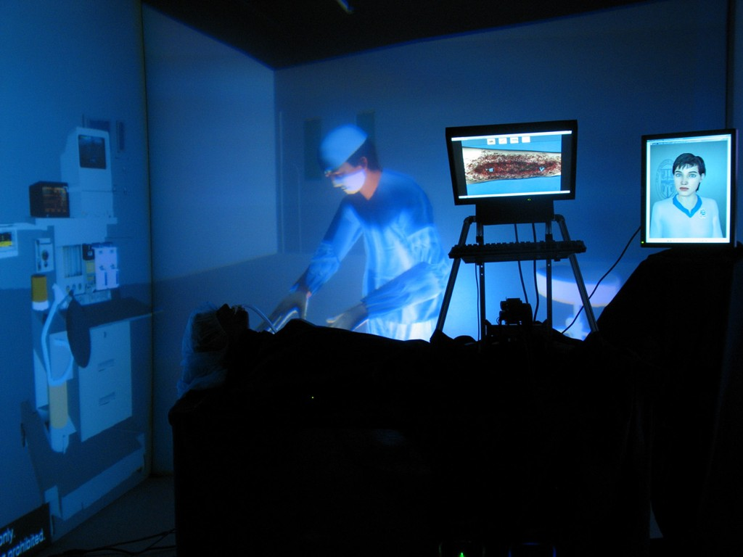
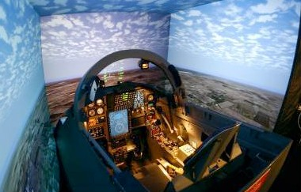
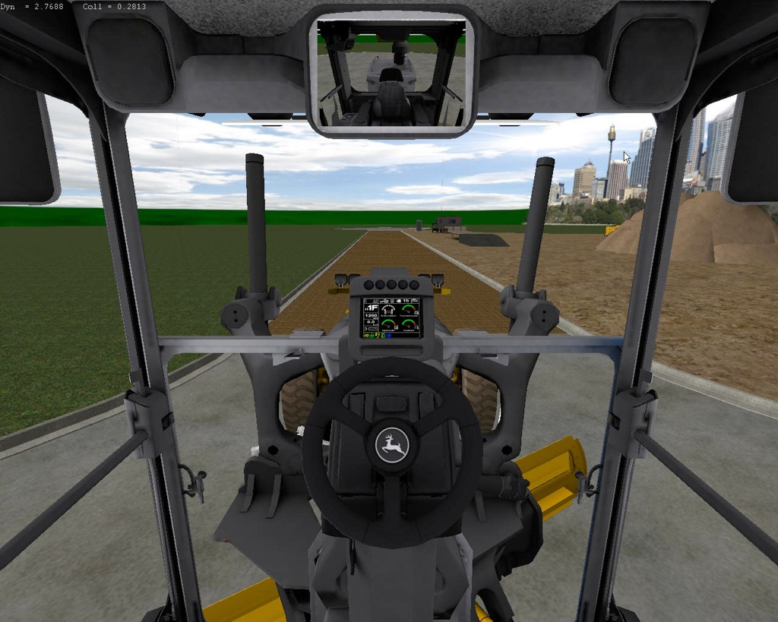
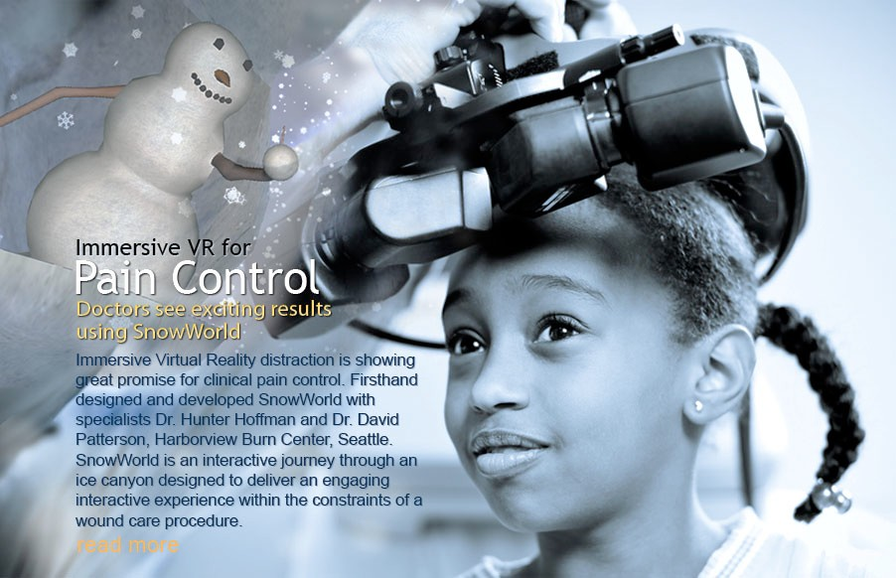
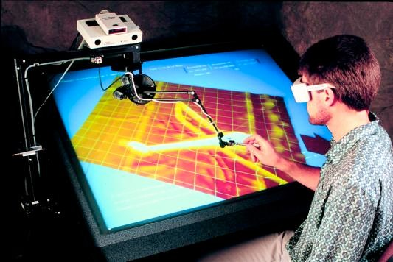
Types of VR

Slide 17
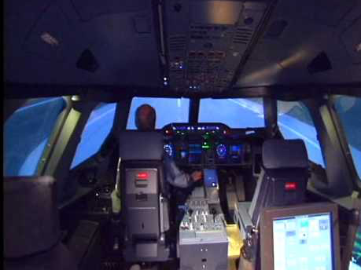
Flight Simulator (CAE)
https://youtu.be/ySixEkDOkOk

Slide 18
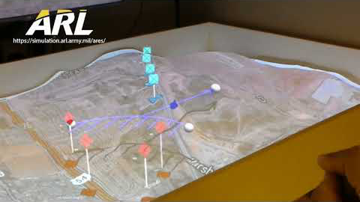
Mixed Reality Tabletop
https://youtu.be/DSstuycfJag

Slide 19
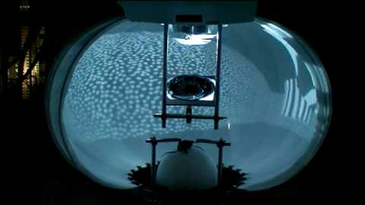
Mouse in VR Maze
https://youtu.be/1DJOTEDBA2c

Slide 20
Other Definitions
Virtual reality is…
A computer technology that replicates an environment, real or imagined, and simulates a user's physical presence and environment to allow for user interaction. (Wikipedia)
Electronic simulations of environments experienced via head mounted eye goggles and wired clothing enabling the end user to interact in realistic three-dimensional situations. (Coates, 1992)
An alternate world filled with computer-generated images that respond to human movements. (Greenbaum, 1992)

Slide 21
More Definitions
An interactive, immersive experience generated by a computer (Pimental, 1995)
A Computer Generated world in which the user experiences himself to be, and act (Lars-Erik Janlert)
a computer-synthesized, three-dimensional environment in which a plurality of human participants, appropriately interfaced, may engage and manipulate simulated physical elements in the environment and in some forms, may engage and interact with representations of other humans, past, present, or fictional, or with invented creatures. (Nugent, 1991)
a way to visualize, manipulate, and interact with computers, and extremely complex data (Isdale, 1998)
it's a cartoon world you can get into (Larijani, 1993)

Slide 22
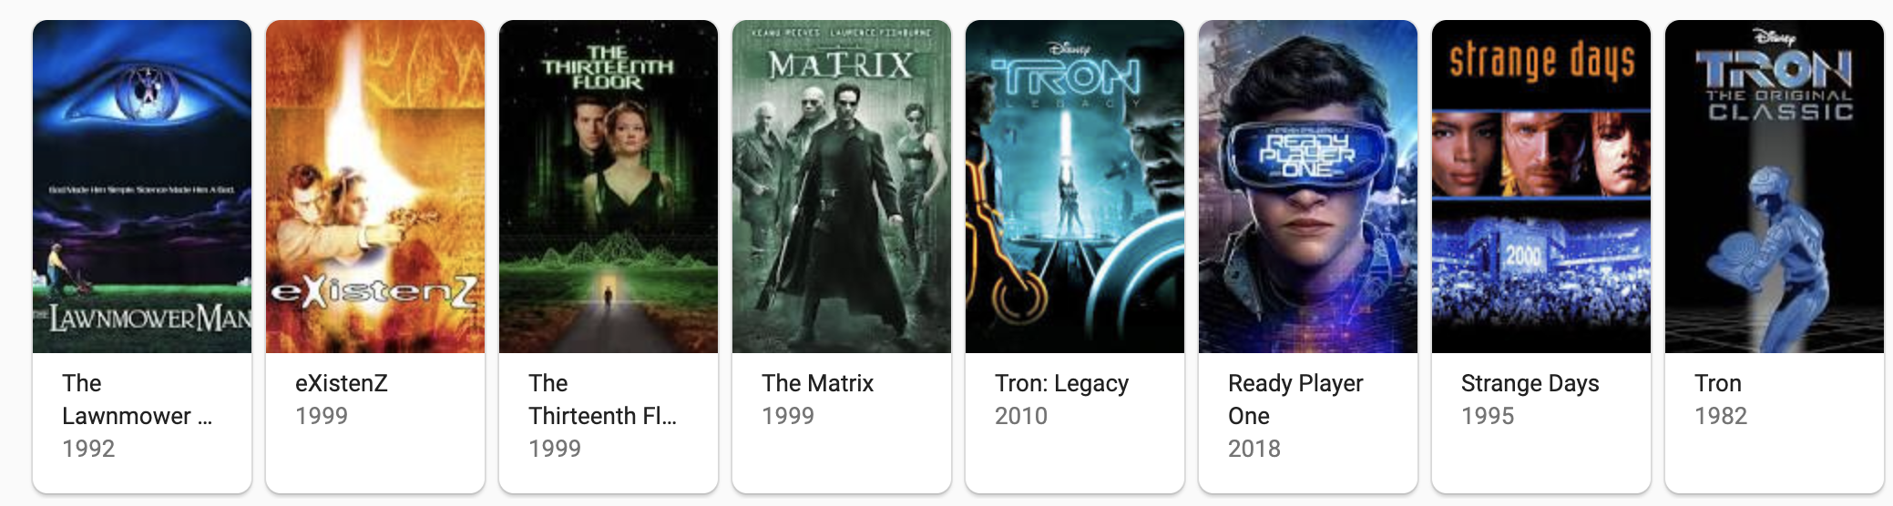
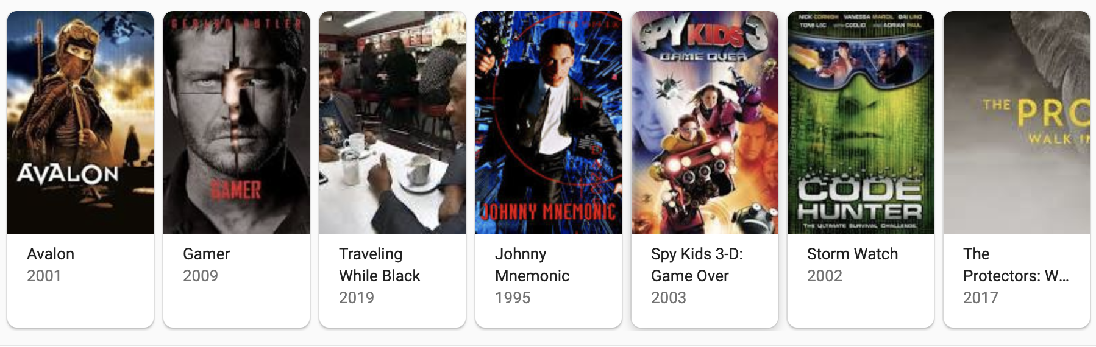
VR in the Movies

Slide 23
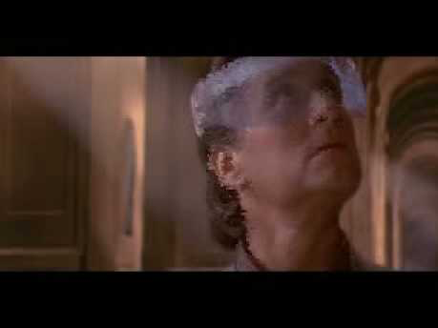
The Disclosure (1992)
https://youtu.be/VFkyV7d5t8o

Slide 24
Virtual Environment (VE)
A computer generated and maintained world that a user can be placed ”in”
Surrounds the user (First person view, 3D/Stereo)
Using ‘all’ modalities—vision, hearing, balance, touch, smell, taste (i.e., Presence)
The world behaves as expected, or as needed by the application—in real-time with direct interaction (grabbing, pushing, pointing, ...)
VR == VE
Used synonymously with virtual environment in most cases

Slide 25
Basic virtual environments
3D graphics
Standard displays (desktop monitor)
Mouse, keyboard, game controller for input
User can view and navigate

Slide 26
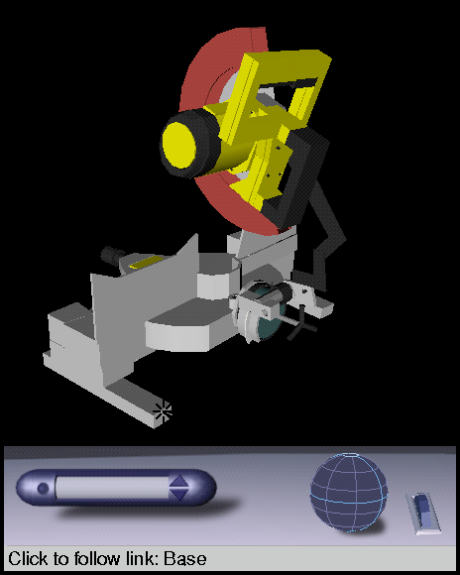
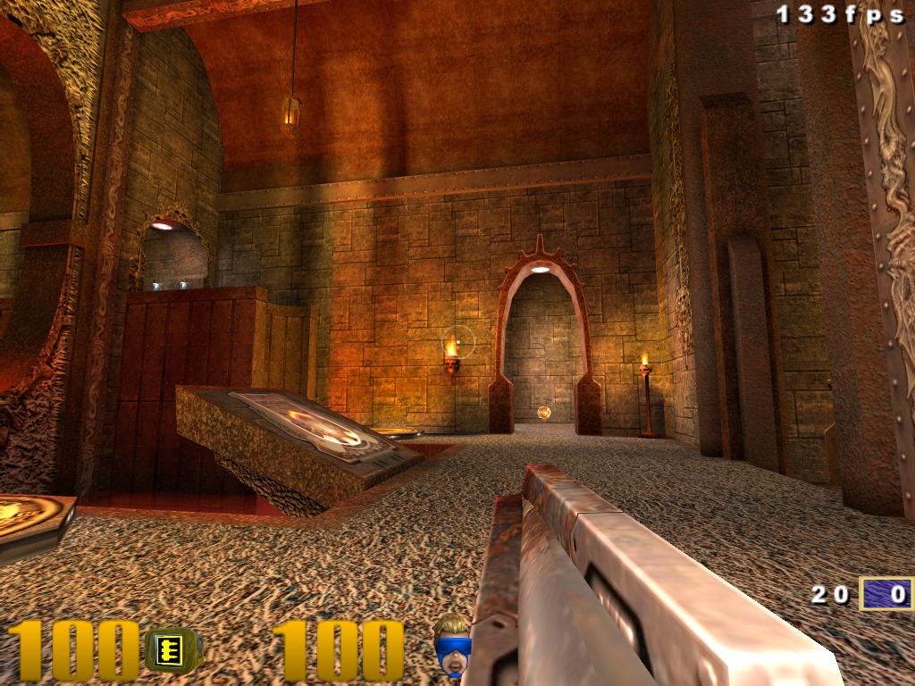
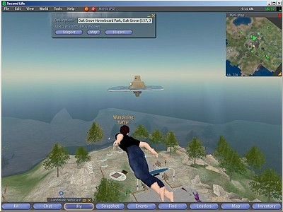
Basic virtual environments

Slide 27
Limitations of basic VEs
Occlusion problems
Depth perception issues
Lack of precise spatial understanding
Difficult to control the viewpoint in 3D
Don’t support “productive work”
VR helps to overcome these

Slide 28
Key Hardware Characteristics for VR
Virtual Reality has three key characteristics
3D stereoscopic display
Wide field of view display
Low latency tracking
When these three things are combined they provide a minimum for a compelling immersive experience

Slide 29
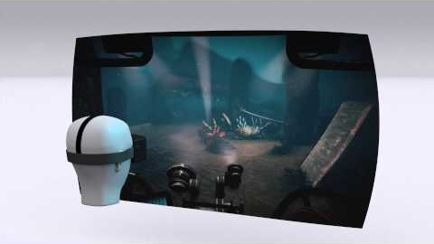
Defining Characteristics
https://youtu.be/FPcbBJbGhmk

Slide 30
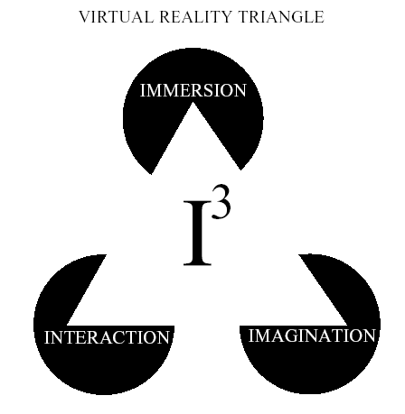
Key Experience Characteristics of Virtual Reality

Slide 31
Immersion
“The extent to which the computer displays are capable of delivering an inclusive, extensive, surrounding and vivid illusion of reality to the senses of a human participant” [Slater and Wilbur 1997]
Immersion measures quality of experience the system (hw/sw) is capable of delivering.
Example VE? Immersive?
This PPT No
3D Cinema No
Desktop Video Game Yes
HMD Yes
No Yes
Yes/No Yes

Slide 32
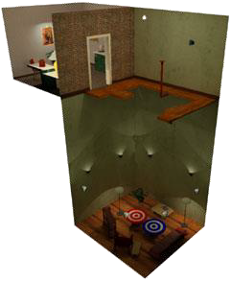
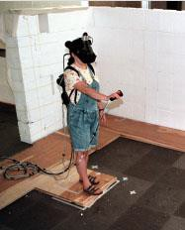
Immersion
Produced by:
Quality of graphics/sound
Enveloping environment
Natural interaction
Realism
Responsiveness - Consequences
Flight simulators, pilots grounded when crashing
Police training with “bullet vest”
Walking Experiment at
UNC – Chapel Hill

Slide 33
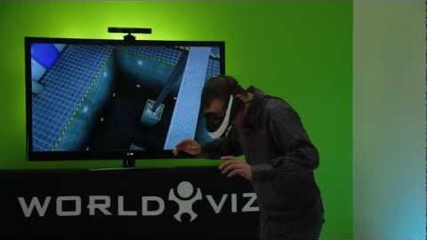
Presence – Suspension of disbelief
Immersion – sensation of being in an environment
mental immersion – suspension of disbelief
physical immersion – bodily entering the medium
https://youtu.be/Q0HG3FJcPtA

Slide 34
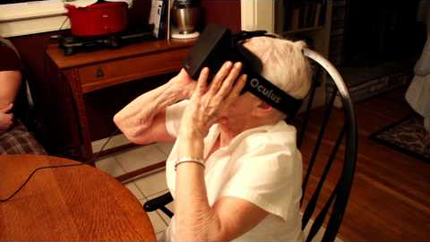
VR Experience
https://youtu.be/pAC5SeNH8jw

Slide 35
Presence
Presence – The feeling of being present somewhere
Virtual Presence – the feeling of being present in a simulated environment
Virtual presence…
“Is experienced by a person when sensory information generated only by and within a computer compels a feeling of being present in an environment other than the one the person is actually in” (Sheridan, 1992, pg.6)
If immersion is connected to characteristics of the technology used, presence is a state of consciousness. (i.e., immersion + imagination)

Slide 36
Presence
Presence – (mentally immersed) the participant’s sensation of being in the virtual environment (Slater)
Why is it important?
It is easier to understand and interact with a 3D world if you are there.
Sense of presence improves with realism
Some aspects of realism weigh more heavily than others (e.g. motion vs. Gravity, texture vs. Shadows)
Amount of realism necessary is dependent on the application.
Need to identify the necessary stimuli.

Slide 37
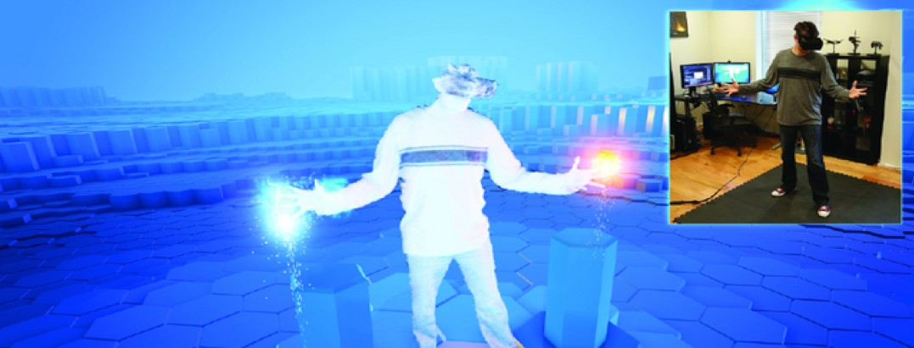
Presence …
“The subjective experience of being in one place or environment even when physically situated in another”
Witmer, B. G., & Singer, M. J. (1998). Measuring presence in virtual environments: A presence questionnaire. Presence: Teleoperators and virtual environments, 7(3), 225-240.

Slide 38
Immersion vs. Presence
Immersion: the extent to which technology delivers a vivid illusion of reality to the senses of a human participant.
Presence: a state of consciousness, the (psychological) sense of being in the virtual environment.
So Immersion produces a sensation of Presence
Goal of VR: Create a high degree of Presence
Make people believe they are really in Virtual Environment
Slater, M., & Wilbur, S. (1997). A framework for immersive virtual environments (FIVE): Speculations on the role of presence in virtual environments. Presence: Teleoperators and virtual environments, 6(6), 603-616.

Slide 39
How to Create Strong Presence?
Use Multiple Dimensions of Presence
Create rich multi-sensory VR experiences
Include social actors/agents that interact with user
Have environment respond to user
What Influences Presence
Vividness – ability to provide rich experience (Steuer 1992)
Using Virtual Body – user can see themselves (Slater 1993)
Internal factors – individual user differences (Sadowski 2002)
Interactivity – how much users can interact (Steuer 1992)
Sensory, Realism factors (Witmer 1998)

Slide 40
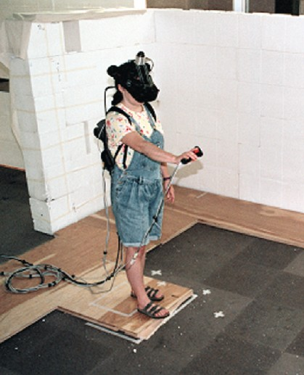
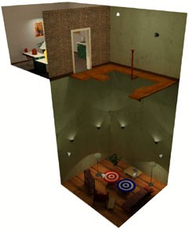
Example: UNC Pit Room
Key Features
Training room and pit room
Physical walking
Fast, accurate, room scale tracking
Haptic feedback – feel edge of pit, walls
Strong visual and 3D audio cues
Task
Carry object across pit (walk across or around)
Dropping virtual balls at targets in pit
http://wwwx.cs.unc.edu/Research/eve/walk_exp/

Slide 41
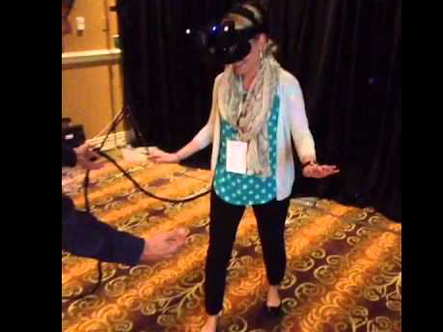
Typical Subject Behavior (from a different experiment)
https://youtu.be/VVAO0DkoD-8

Slide 42
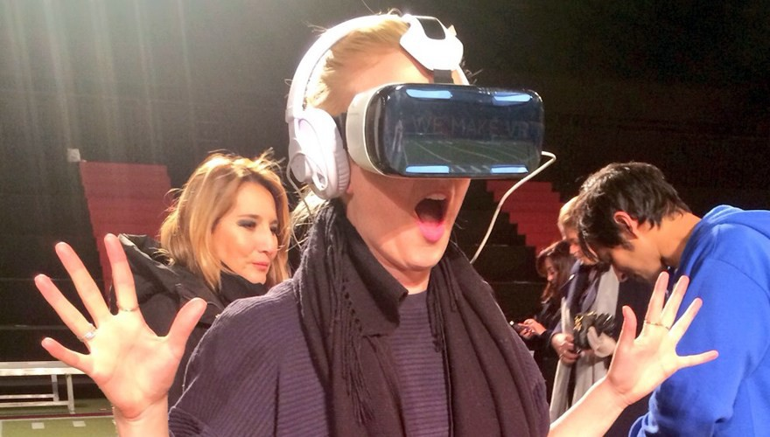
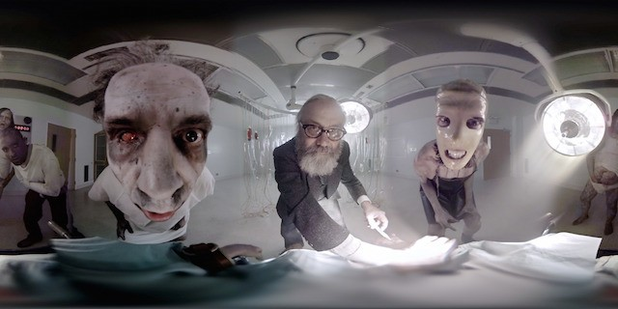
Benefits of High Presence
Leads to greater engagement, excitement and satisfaction
Increased reaction to actions in VR
People more likely to behave like in the real world
E.g. people scared of heights in real world will be scared in VR
More natural communication (Social Presence)
Use same cues as face to face conversation
Note: The relationship between Presence and Performance is unclear – still an active area of research

Slide 43
Immersive, Telepresence, VE, or VR?
playing second life (first person video game)
watching a movie
video conferencing
listening to the music
playing a third person video game
talking on the phone
reading a book
looking at a painting
being under the influence of a hallucinogenic drug

